Slide 1
Interview preparation

Slide 2
Resume Questions
Introduce About yourself?
What is the Project you contributed During the internship?

Slide 3
System design questions
Explain Oauth with authorization flow
Explain jwt with example
What is the difference sso and Oauh?
Explain Http and https?
What is caching?
What is load balancing, Elastic search, Websocket, webhook, server sent event
Middleware
Authentication and Authorization
Scaling the system – types of Scaling horizontal and vertical scaling
What is kafka, CQRS and saga design patter?
What is MCP Server and also what is MVC?
Explain all HTTP status code?
What is REST?
Types of attack in web applications
What is solid principle and Agile , scrum methodology?
What is Multithreading and concurrency?
What is diff btw Multithreading and Asynchronous?

Slide 4
Computer network questions
What is computer network?
What is node, link, protocol, ISP?
What is Client server architecture and peer to peer architecture?
What is HTTP why it is stateless and HTTPS, UDP, TCP and IP?
What is Lan, Wan, Man,
What is Topology and its types?
What is cookies, DNS and SMTP server?
Explain subnetting and Routing
Explain OSI architecture and also TCP architecture how its working?
What is Firewall?

Slide 5
Operating System questions
What is an operating System?
What is the most popular Operating System at present?
What is process vs thread?
Main functions of an Operating system?
What is Kernal? Different kinds of kernals?
What is diff btw Monolithic and Micro kernal?
What are device Drivers?
What is Paging?
What is process in OS?
What are the various attributes associated with process?
What is Thead?
What is Deadlock?
Necessary condition that can lead to deadlock?
What is bankers Algorithm?
What is virtual memory?

Slide 6
Operating System questions
What is Demand Paging?
What is thrashing?
What is page fault?
What is the diff btw segmentation and paging?
What is the diff state of a process?
What is a scheduling Algorithm? Name the different types of scheduling algorithm?
What is zombie processing?
What is the diff btw multi threading and multi processing?
What is the diff btw starving ,aging and context swtiching?
How os is booting?
What is semaphore?
Mutex and critical condition?

Slide 7
Java Interview questions
What is Java?
Explain why java is platform independent programming language?
Diff btw java and c++?
What is class and object? [using new keyword]
Explain oops? And its types and what is dynamic binding? [programming approach ] [Fundamental machanism] [Restrict direct access state]
What is default, finalize, super, this ,type casting, instance of, static keywords?
What is the difference btw abstraction and interface?
What is Access modifier and explain its types?
How java tackle multiple inheritance through the Interface?
Explain String and String pool working?
Explain about the garbage collector?
Explain what is wrapper class?
What is JDK, JRE, JVM
What is package in java?

Slide 8
Java Interview questions
What is purpose of do the keywords final, finally and finalize?
Constructor and Method and its questions? [Like override by final]
What Is hashCode(), clone(), getClass(), finalize()?
What is Object class and what is object Cloning?
What is hashTable and how it utilizes hashcode()?
Explain Stack, queue, linkedList, dequene , enqueue ,priority queue, linkedHashset?
If key is null in HashMap then where that entry will store in map ?
What Is the difference btw Process and thread?
What is thread? And its life cycle?
What is the diff btw multithreading and concurrency?
What is the dff btw wait() vs sleep()?
What is the diff btw run() vs start()?
What is pessimistic approach? And how it maintain concurrency ? And what is Lock free mechanism?
What is Thread pool executor? And what is the diff btw this and Scheduled Thread pool executor?
What is Difference btw runnable and callable?
What is the diff btw platform thread and virtual thread?
What is the diff btw comparator and comprator?

Slide 9
Spirng boot Interview questions
Explain how the spring boot workflow or bean life cycle?
What is spring boot?
What is the diff btw spring and spring boot?
Explain @Sping boot annotation what all are the Annotation there?
What all are the spring boot starter?
What is the role of application.property?
What is spring initializer and CLI?
What is the diff btw RequestMapping , Component and bean?
What is spring boot dependency management?
What is spring jpa explain its architecture?
What is spring MVC?
What is bean wiring?
What is spring data REST?
Need to learn all the annotations
Describe HTTPS request through the spring boot application? [Need to learn]
What is diff btw Controller and RestController?
What is profiles in java?
What is spring Boot Actuator?
What is Dependency injection and its types?

Slide 10
Spirng boot Interview questions
What is entity Life Cycle?
What is ORM explain in spring boot?
Explain the flow how Entity store into database?
What is Dynamic bean initialization?
Explain what is Beans scopes and explain Singleton and proto?
What is profile, AOP, Transactional, Async, interceptor and Filters?
Explain spring security workflow?
Explain types of attacks? –
Microservices and its definitions?
Types of attack In spring boot?

Slide 11
Docker interview question
What is docker ?

Slide 12
Explain Sorting techniques
Bubble sort
Selection sort
Merge sort

Slide 13
DBMS interview questions
What is dbms?

Slide 14
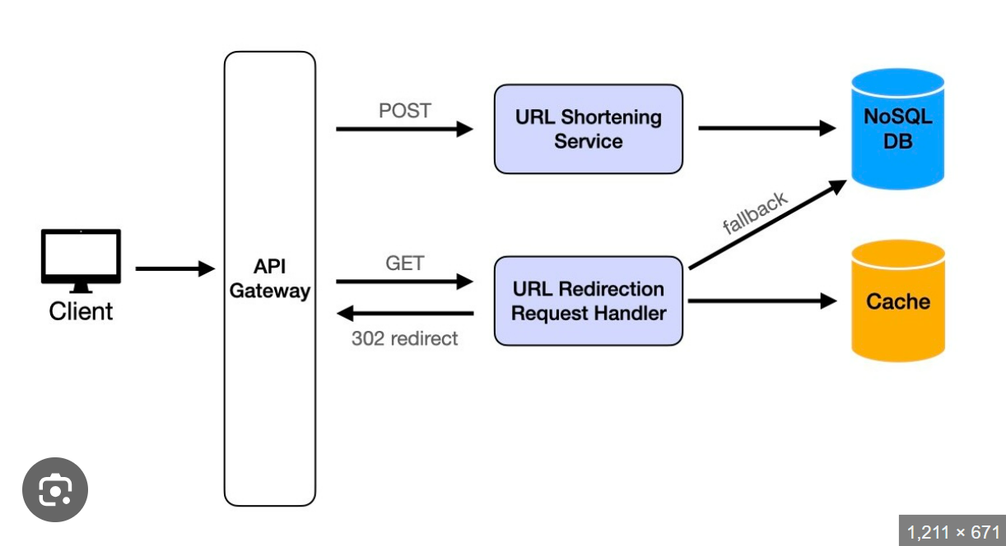
Project Demo
My first project is a URL Shortener application. I built it using Java Spring Boot, React.js, and PostgreSQL as the database.
It has two main endpoints:
URL Shortener Service – This handles POST requests. When a client sends a long URL, this service generates a shortened URL, stores it in the database, and uses the shortened URL as the primary key with the original long URL as its value.
URL Redirection Request Handler – This handles GET requests to access a shortened URL. It first checks if the mapping exists in Redis (cache memory). If it’s not found in Redis, it falls back to the database to fetch the original URL. And Redirect to the original url. [302] Redirect httpstatus code

